Slide 1
Capstone Project – The battle of neighborhoods
Exploration of the neighborhood data of the cities Toronto and New York

Slide 2
1. Introduction
What are the characteristics of someones neighborhood in NY (e.g. in Riverdale, NYC)?
If he/she would like to move to Toronto, which neighborhoods are comparable and due to which characteristics?

Slide 3
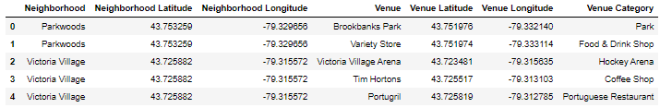
2. Data
Usage of Foursquare data for finding characteristics of neighborhoods regarding their venues
In total 7739 venues for 409 neighborhoods

Slide 4
3. Methodology
After wrangling the data (one hot encoding, grouping) k-means-clustering was peformed
Parameter: n-cluster: 5 ; random state: 0

Slide 5
4. Results
Riverdale, NYC is characterized by the following venue categories
Park and Playground are more represented than the other categories

Slide 6

4. Results
Riverdale is in cluster 3
Comparable cities in Toronto according to the cluster are the following

Slide 7
5. Discussion
The found neighborhoods can be used as a first approach when searching a neighborhood in Toronto similar to Riverdale, NYC
This result grounds mainly in the two venue categories Park and Playground
Refinement could be done by weighting the venue categories according to one personal preferences

Slide 8
6. Conclusion
This analysis gives an approach on how to select similar neighborhoods to the current one when moving to another city
The approach was performed as an example for the cities Toronto and New York
Several neighborhoods in Toronto with similar characteristics to Riverdale were found

